Slide 1

Get hungry for ReactiveUI
…or stop waiting
Thomas Burkhart
@thomasburkhartb
blog.burkharts.net

Slide 2
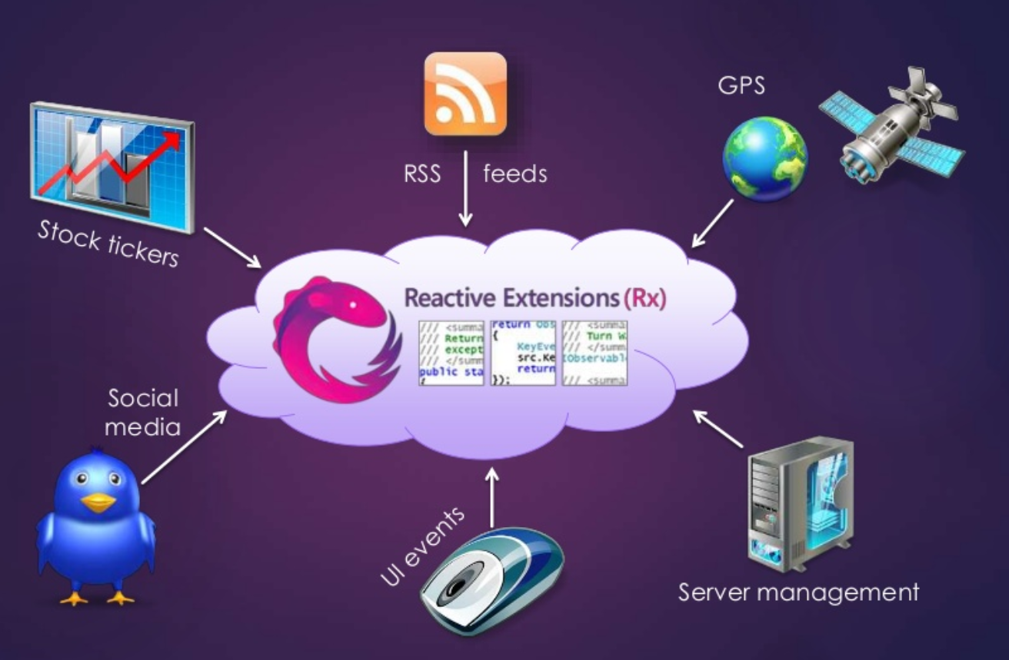
Reactive Extensions(Rx)
Rx is Linq for Events
Notes:
Reactive UI doesn‘t work without Reactive extensions. So before we come to RxUI we need to have look on Rx especially in an App context
It‘s impossible to teach you Reactive programming or RxUI in 50 minutes so I will give you an impression what can be done with it
Although React or JavaRx are well known view people know that Rx was invented by MS

Slide 3



Of Observables and Subscriptions
Eventsource
Observable
Rx processing pipeline
.SelectMany()
.Where()
.Throttle()
Subscriptions
e.g. .Subscribe(data => Console.WriteLine(data.ToString()));
Notes:
An Event source publishes an Observable for it‘s events
The Rx pipeline is created by chaining Extension methods which leads to an event processing without any side effects

Slide 4
Subjects
class Subject<T> : IObservable<T>, IObserver<T>
{
IDisposable Subscribe( Action<T> OnNext,
Action OnCompleted,
Action<Exception> OnError);
void OnNext(T value);
void OnCompleted();
void OnError(Exception error);
}
Simplified pseudo code!!!
Notes:
One type of Event source are subjects
Recognize the Idisposable that a subscription returns. If you Dispose that the Subscription is canceled

Slide 5
Replacing Message Center with Rx
public interface IMessageBroker
{
IObservable<string> Messages { get;}
void QueueMessage(string message);
}
Notes:
Messaging Center has many flaws:
Not Typed
Hard to debug

Slide 6
Splat
var messageBroker = new MessageBroker();
// Register a real instance of MessageBroker
Locator.CurrentMutable.RegisterConstant<IMessageBroker>(messageBroker);
// Usage
var broker = Locator.Current.GetService<IMessageBroker>();
broker.QueueMessage("From PCL Project");
branch: MessageBroker

Slide 7
Handling OS Callbacks with Rx
public interface IRxMediaPlayer
{
IObservable<PlayerError> Errors { get; }
IObservable<PlayerState> PlayerStates { get; }
IObservable<PlayPosition> Positions { get; }
IObservable<PlayPosition> BufferStates { get; }
void InitPlayer();
void SetMediaUrlSource(string url)
void Play();
void Pause();
void Stop();
}
Notes:
Sample from RxMediaPlayer

Slide 8
.Net events to Observable
ConnectionState =
Observable.FromEventPattern<ConnectivityChangedEventHandler, ConnectivityChangedEventArgs>(
handler => handler.Invoke,
h => CrossConnectivity.Current.ConnectivityChanged += h,
h => CrossConnectivity.Current.ConnectivityChanged -= h)
.Select(x => x.EventArgs.IsConnected)
IDisposable ConnectSubscription =
ConnectionState.Subscribe(connected => Console.WriteLine(connected.ToString()));

Slide 9
Hot and Cold Observables
Hot Observables like:
.net Events (Buttons, Mouse)
OS Callbacks
Subjects
issue events independend of the existence of a subscription
Cold Observables like:
converted async functions calls
are created and issue events on every subscription

Slide 10
Converting async functions…
var result = await restAPI.GetWeather();
List<CityWeatherItemViewModel> list = new List<CityWeatherItemViewModel>();
foreach (var city in result.Cities)
{
list.Add(new CityWeatherItemViewModel()
{
Name = city.Name,
Temperature = city.Main.Temp,
});
}
CityWeatherList = list;
branch: UsingAwait

Slide 11
…to Observables
restAPI.GetWeather()
.SelectMany(result => result.Cities)
.Select(city => new CityWeatherItemViewModel()
{
Name = city.Name,
Temperature = city.Main.Temp,
})
.ToList()
.ObserveOn(RxApp.MainThreadScheduler)
.Subscribe(list => CityWeatherList = list);
branch:SingleColumnListView
Notes:
Observables can be converted to Ienumarable and vice versa

Slide 12
Calling Async Functions from constructors
Calling async functions from constructors is not possible without some tricks using Tasks
With Rx you don‘t wait for a function fo come back!
It‘s more like setting up a trap for data/events
Which is possible to do in a constructor
The code in the subscription will be called completely asyncronously from the constructor

Slide 13
Creating Complex ItemViewModels
restAPI.GetWeather()
.SelectMany(cities => cities.List)
.Buffer(2)
.Select(cities => new CityWeatherItemViewModel()
{
Name = cities[0].Name,
Temperature = cities[0].Main.Temp,
Name2 = cities.Count > 1 ? cities[1].Name : "",
Temperature2 = cities.Count > 1 ? cities[1].Main.Temp : 0,
})
.ToList()
.ObserveOn(RxApp.MainThreadScheduler)
.Subscribe(list => CityWeatherList = list);
branch: DualColumnListView
Notes:
Sample of AlbumsView from JistTV

Slide 14
ReactiveUI
Is an cross platform MVVM framework
Xamarin Forms
Xamarin Android
Xamarin iOS
Xamarin Mac
Windows Forms
WPF
UWP
based on Rx

Slide 15

Stop (a)waiting
Notes:
Define your Event traps concisely withut side effects

Slide 16
ReactiveObject
To fully use the power of RxUI ViewModels have to derive from ReactiveObject and Views have to implement IViewFor<ViewModelType>
Then you get:
Reactive Bindings
ReactiveCommands
PropertyChange observation with WhenAnyValue()
ReactiveObject implements INotifyPropertyChanged and offers Helperfunctions to implement properties via RaiseAndSetIfChanged
ReactiveUI.Fody makes live much easier

Slide 17
Reactive Bindings
Are defined in Code
Are Type safe
Fully supported by Intellisense
Built in Type Conversion
Target Properties must implement INotifyPropertyChanged
branch: Creating Bindings I & II
Notes:
Start with Create_Bindings I
Show Fody
Then point out that we move display transformations from the ViewModel to the View (Image URLs)
Show Binding debugging

Slide 18
ReactiveCommand
Prevents double invocations
Offers Observables for
IsExcuting
ThrownExceptions
Takes an Observable for CanExecute
Has overloads for async methods
branch: ReactiveCommandRefresh
Notes:
Start with added Button in MainPage and show the command binding in MainPage.xaml.cs
Show Debug output for IsExceuting

Slide 19
WhenAnyValue
Allows to monitor any reactive property
Creates an Observable for value changes
branch: FilterWith WhenAny
Notes:
Show also WhenAnyValue in MainPage.xaml.cs

Slide 20
Reactive Searchbox
[Reactive] public string SearchText {get;set;}
// Filter changes
IObservable<string> TextChanging = this.WhenAnyValue(x => x.SearchText)
.Throttle(TimeSpan.FromMilliseconds(500));
TextChanging
.InvokeCommand(FilterCommand);
branch: FilterWith WhenAny
Notes:
Show also how Elegant we added the Filter to the UpdateMethod

Slide 21
Merging Busy Tasks
//we want to prevent that the filter command is executed
//while one of the others is running
CanFilter = DoSomeImportantOtherTaskCommand.IsExecuting
.Merge(UpdateCommand.IsExecuting)
.DistinctUntilChanged()
.Select(b => !b);
branch: DualColumnListView
Notes:
Show the Canfilter state in the Output

Slide 22
Ressources
https://reactiveui.net/
https://reactiveui.net/docs/resources/videos
By registering to the ReactiveUI newsletter you can get an invitation to the RxUI Slack
Source code of Demo:
https://github.com/escamoteur/ExpertDayDemo
Notes:
Rx is a Journey

